Slide 1

SEP 767 - Multivariate Statistical Methods for Big Data Analysis and Process Improvement
German Credit Risk Prediction
Prathamesh Joshi
400485705
MEng Systems and Technology – Automation and Smart Systems

Slide 2
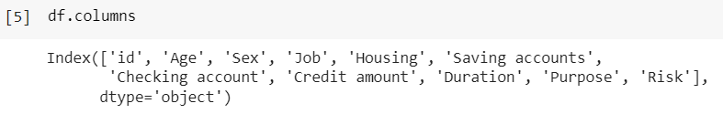
Project Aim and Dataset Description
Dataset link - https://www.kaggle.com/datasets/kabure/german-credit-data-with-risk
The dataset consists of 9 features and 1 target variable.
The project aims to predict whether the given person will be a good credit for the bank or a bad credit. In other words basically if the bank gives a loan, will that person repay it or not.
This is a binary classification problem where Risk attribute has 2 classes – Good or Bad.

Slide 3
Age: This variable bank contains the age information of the customers.
Sex: This variable contains the gender information of the bank customers.
Job: This variable contains occupational information of bank customers. Professions are divided into four categories according to skill level. (0 - unskilled and nonresident, 1 - unskilled and resident, 2 - skilled, 3 - highly skilled)
Housing: This variable includes the housing status of the bank customers.
Saving Accounts: This variable bank contains customers savings information. Customers savings are classified as little, moderate, quite rich, rich.
Checking Accounts: This variable show the cash in the accounts of bank customers - classified as little, moderate, quite rich, rich.
Credit Amount: This variable shows how much credit the bank customers get.
DM :Deustsche Mark is used as currency.
Duration: This variable contains the specified time to pay the credit.
Purpose: This variable shows the purpose for which the bank customer taking credit. Taking credit by customers are classified as car, furniture / equipment, radio / TV, domestic appliances, repairs, education, business, vacation / others.
Risk: This variable contains the customers risk information. Customers in the Data Set have previously taken credit from banks. A value of 1 was given for customers who paid the credit and 0 for customers who could not.

Slide 4
Exploratory Data Analysis
Observations
Some numerical features like Credit Amount, Age or duration show some outliers.
The target is slightly imbalanced, with more patients good credits than bad
People between the ages of 20 and 40 are more likely than others to seek for credit. The average age of those who apply for a loan is 35.
Males apply for credit/loans at a higher rate than females. Males made up 69% of those who applied for credit, while females made up 31%.
There were almost 600 highly skilled professionals among the 1000 people who asked for a loan. This accounts for 63% of all credit applications received.
Customers with their own properties/houses are more likely to apply for a loan.
When a loan is taken for a duration greater than 25 months then the probability of being a Bad Risk is high as compared to being Good.
Customers with limited savings and little money in checking accounts ask for loans more frequently than those with more or better savings.
The majority of loan applications are for automobiles. This accounts for 33.7% of all applications. Surprisingly, radio/TV is the second most prevalent reason for loan.
When a loan is taken out for more than 25 months, the likelihood of being a Bad Risk outweighs the likelihood of being a Good Risk.

Slide 5
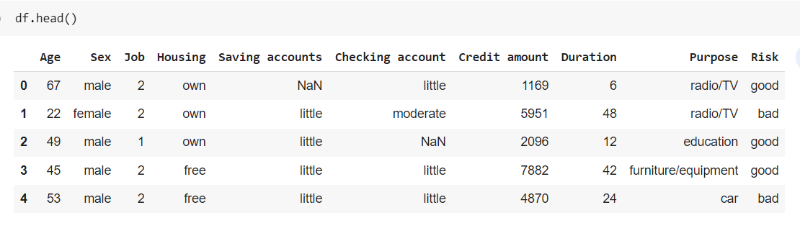
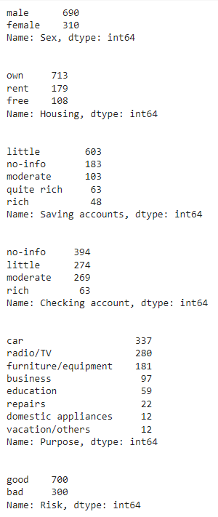
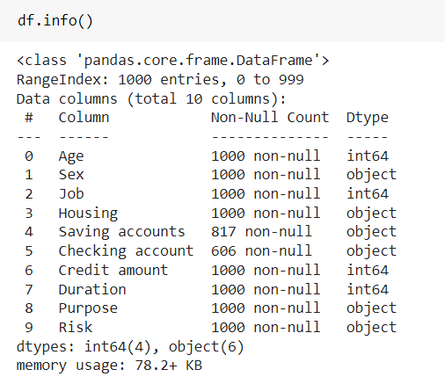
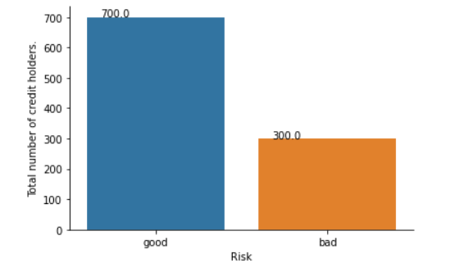
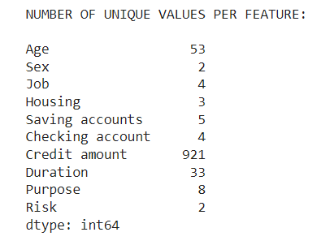
The target variable Risk has 700:300 between "good" and "bad"

Slide 6
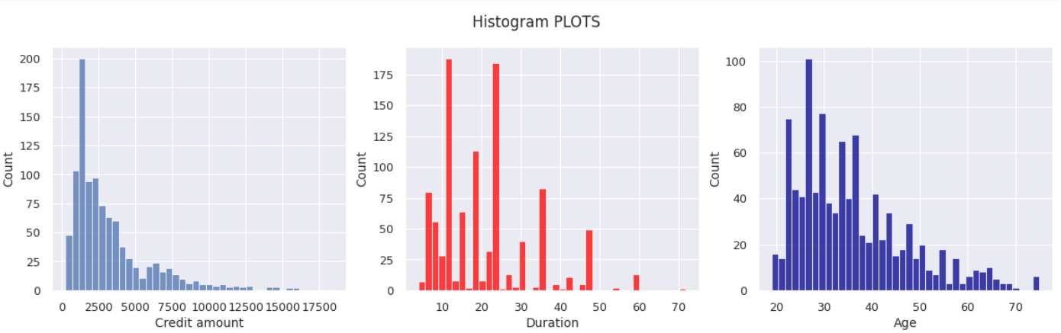
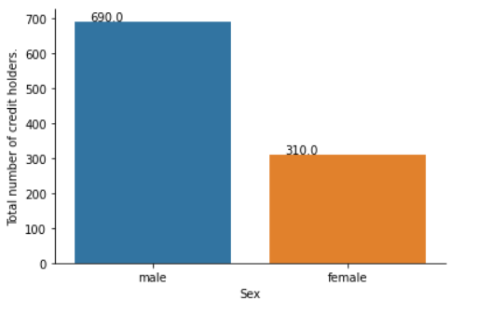
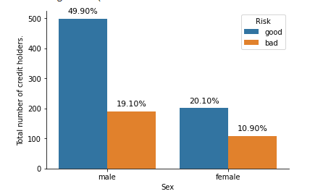
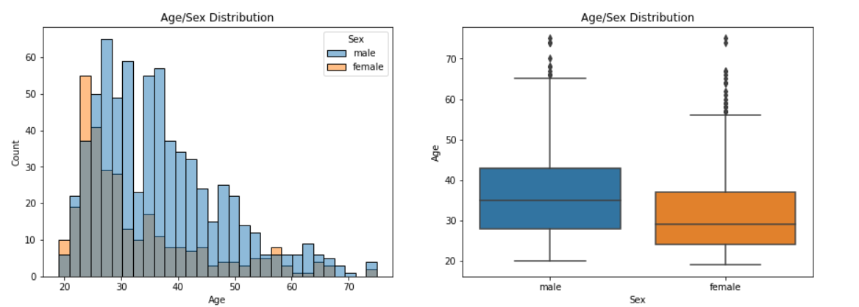
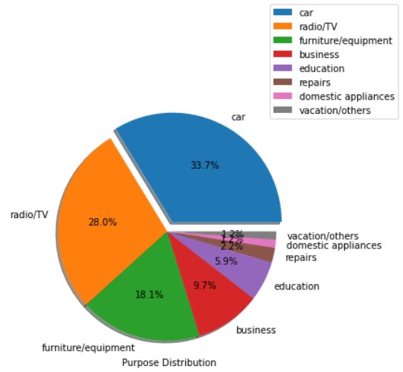
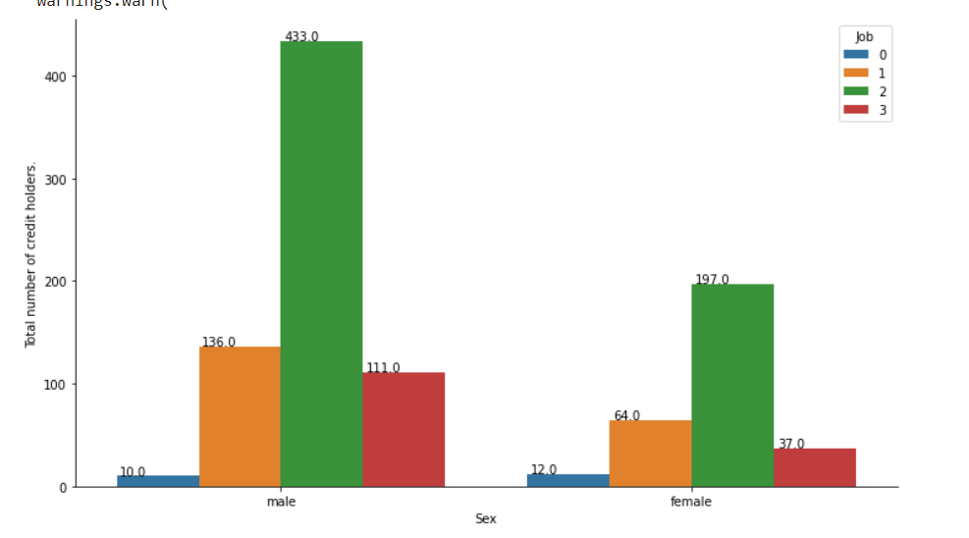
Males take more count of credit from Bank.
Males have lower percentage of bad rating than woman
Most of the credit amount is between 1000- 4500
Most of the people taking loan ages between 20 and 50
Far more males taking loan than females
Young females taking more loans than young males
Older females taking more loan than older males

Slide 7
Data Pre-processing
Steps
Cleaning by dropping unwanted col (like “id”)
Missing values in the two features (Savings/Checking) handled by adding ‘no-info’ in it.
Label encoded all the categorical columns
This was perform compared to One-hot encoding because all the features have more than 2 categories.
Also one hot encoding leads to increase in number of feature space, thus increasing memory consumption
Standard Scaler was used to mean center and scale the data for pca and classification.

Slide 8
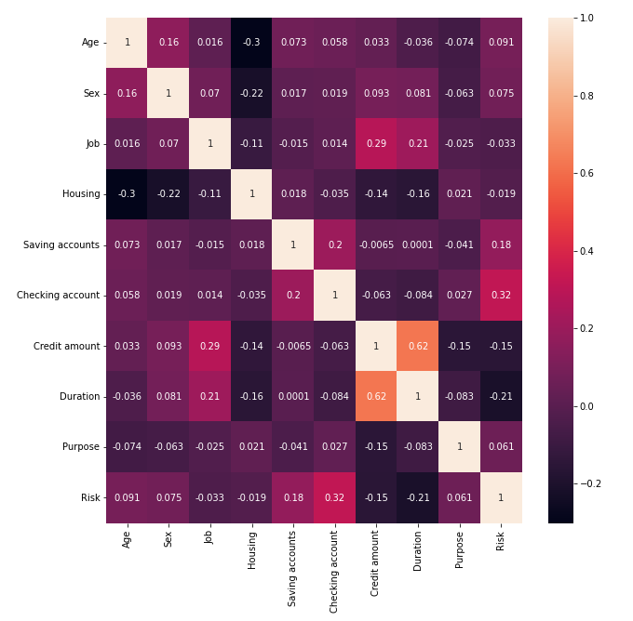
Job, Housing and Sex seem to be having less effect on the risk
Credit amount and duration has the maximum negative corelation on risk which means if duration increases – the chances of risk is more which means risk = 0 in our case

Slide 9
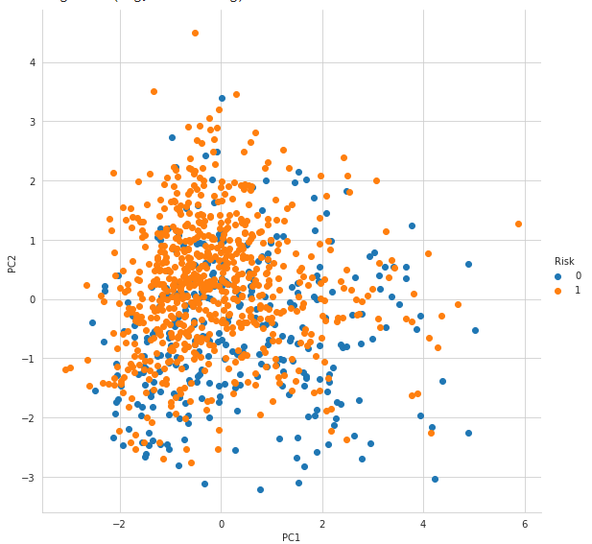
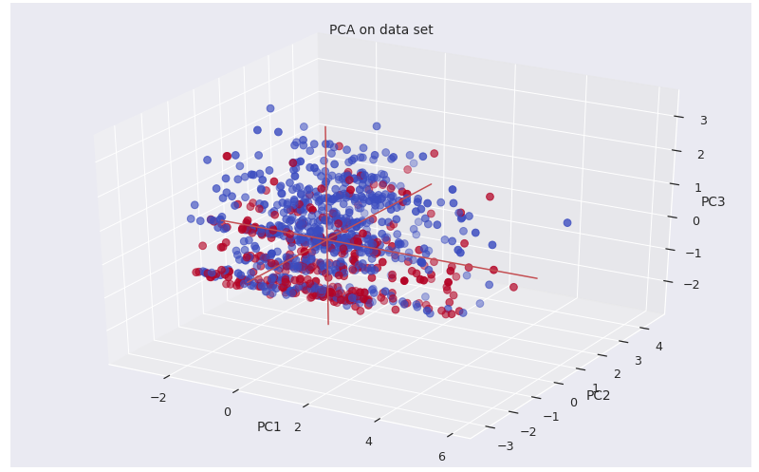
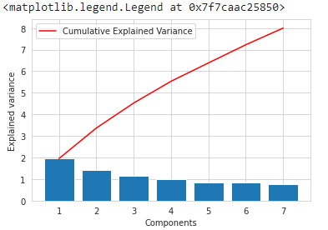




Principal Component Analysis
PCA with 2 components
PCA with 3 components
PCA with 7 components

Slide 10
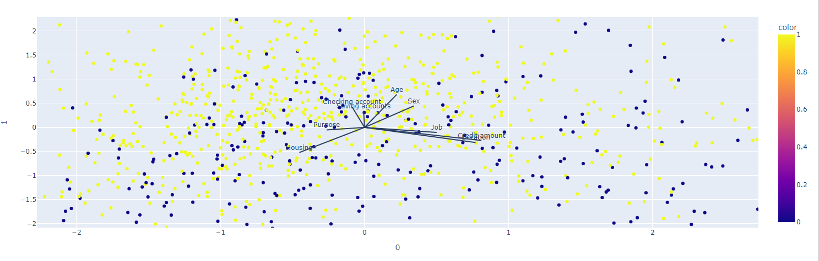
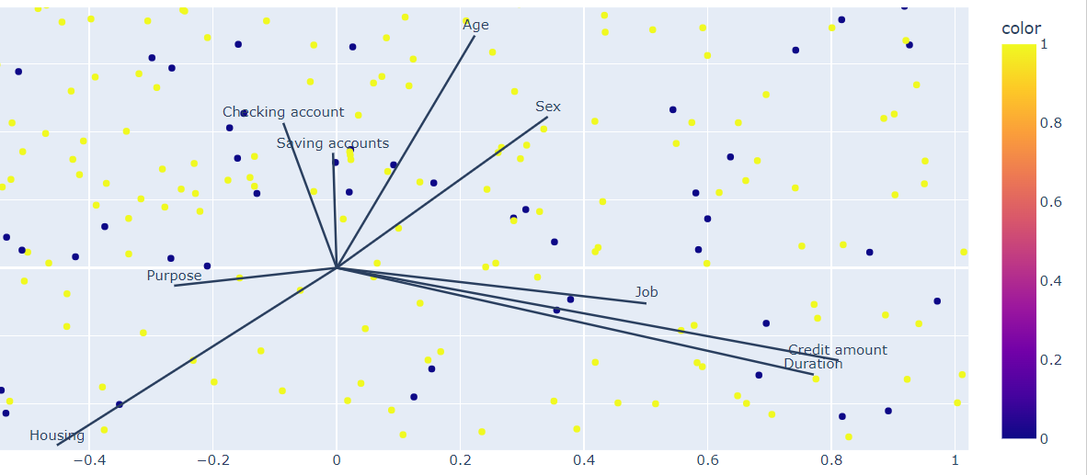
Scores and loadings
Note: Zoomed view of the graphs in screenshots

Slide 11
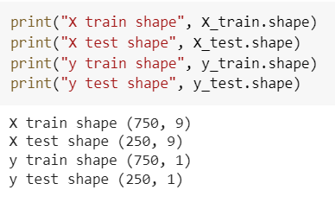
Data Split and Classification Models
Data was split between training set and testing set in the ratio of 75% and 25% respectively, parameters passed
random_state – it will help in randomly shuffle the data before splitting
Stratifying – as our target class is imbalanced – while splitting it will help to equally split the data as much as possible
Following Classification Algorithms were used:
Logistic Regression
K-Nearest Neighbor
Decision Tree Classifier
Random Forest Classifier
XGBoost Classifier

Slide 12

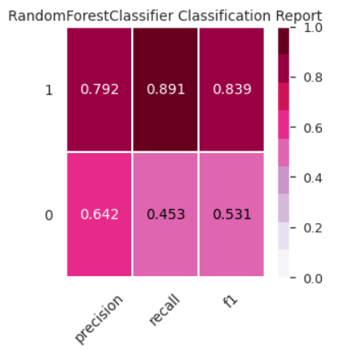

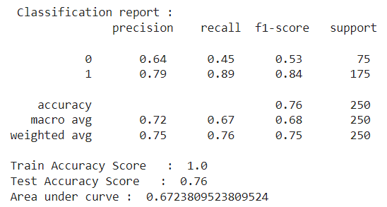
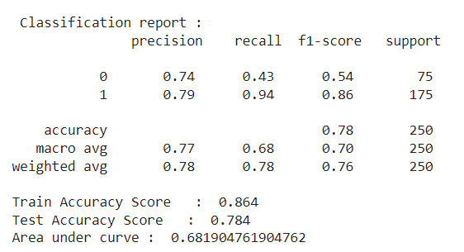
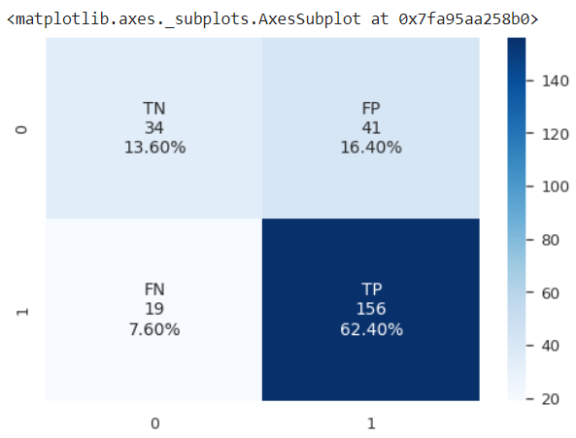
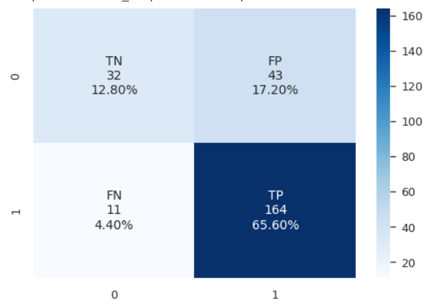
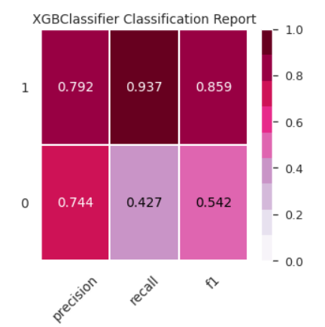
Outputs:
Random Forest Classifier
XGBoost Classifier

Slide 13
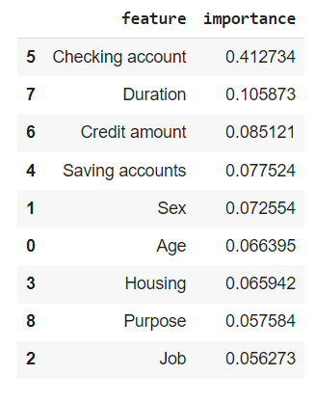
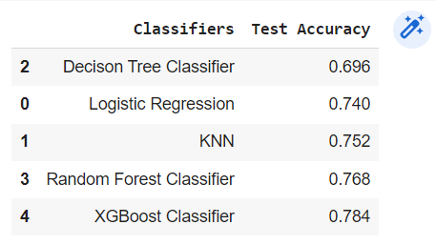
Feature Importance and Model Comparison

Slide 14
References:
Yoga Religia, Gatot Tri Pranoto and Egar Dika Santosa (2020) ‘South German Credit Data Classification Using Random Forest Algorithm to Predict Bank Credit Receipts’, JISA (Jurnal Informatika dan Sains), 3(2), pp. 62–66. doi:10.31326/jisa.v3i2.837.
Hamdy Abeer and Hussein Walid B. (2016) ‘Credit Risk Assessment Model Based Using Principal component Analysis And Artificial Neural Network’, MATEC Web of Conferences, 76, p. 02039. doi:10.1051/matecconf/20167602039.
Arora, N. and Kaur, P.D. (2020) ‘A Bolasso based consistent feature selection enabled random forest classification algorithm: An application to credit risk assessment’, Applied Soft Computing Journal, 86. doi:10.1016/j.asoc.2019.105936.
Raschka, S., 2018. Model evaluation, model selection, and algorithm selection in machine learning. arXiv preprint arXiv:1811.12808
Qasem, M. and Nemer, L. (2020) Extreme Learning Machine for Credit Risk Analysis. Journal of Intelligent Systems, Vol. 29 (Issue 1), pp. 640-652. https://doi-org.libaccess.lib.mcmaster.ca/10.1515/jisys-2018-0058
Sivasankar, E., Selvi, C. and Mahalakshmi, S. (2020) ‘Rough set-based feature selection for credit risk prediction using weight-adjusted boosting ensemble method’, Soft Computing - A Fusion of Foundations, Methodologies & Applications, 24(6), pp. 3975–3988. doi:10.1007/s00500-019-04167-0
Shen, F. et al. (2019) ‘A novel ensemble classification model based on neural networks and a classifier optimisation technique for imbalanced credit risk evaluation’, Physica A: Statistical Mechanics and its Applications, 526. doi:10.1016/j.physa.2019.121073.

